Slide 1
CHM 5175: Part 2.3
Absorption Spectroscopy
Source
Detector
hν
Sample
Ken Hanson
MWF 9:00 – 9:50 am
Office Hours MWF 10:00-11:00

Slide 2
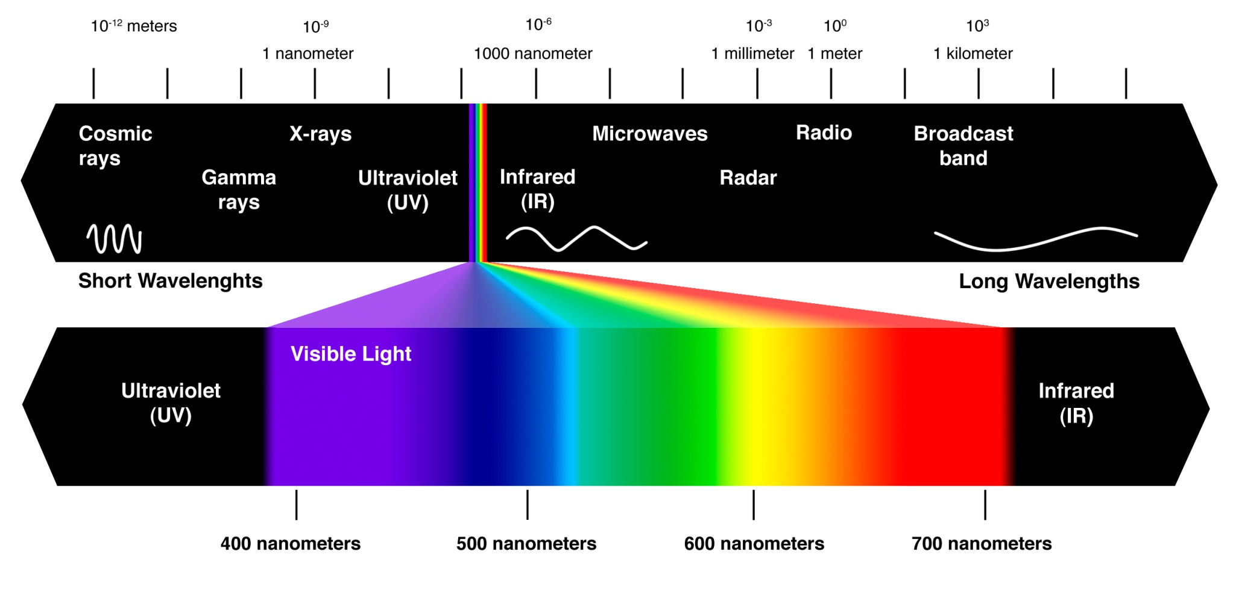
Absorption Spectroscopy
Source
Detector
hν
Sample

Slide 3
Why Absorption Spectroscopy?
Source
Detector
hν
Sample
Color is ubiquitous to humans
1000 x more sensitive than NMR
Qualitative technique (what is in the solution)
Quantitative technique (concentrations, ratios, etc.)
Its easy
It is inexpensive
Numerous applications

Slide 4
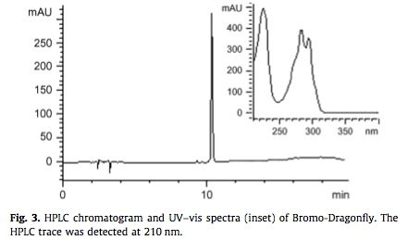
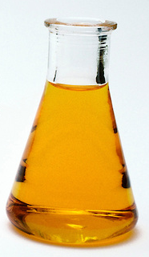
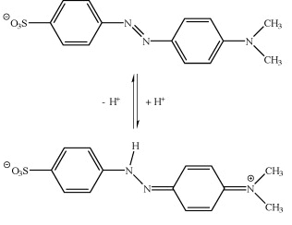
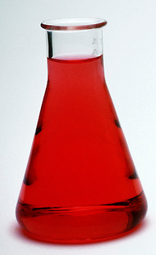
Absorption Spectroscopy in Action
HPLC
pK_{a} Determination
Yellow (pH > 4.4)
Structure Differentiation
Abietic Acid
Levopimaric acid
Red (pH > 3.2)
214 nm
253 nm

Slide 5
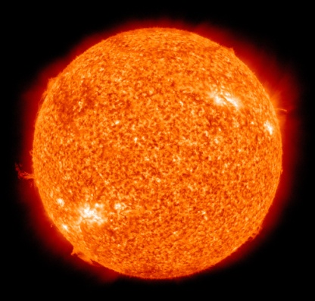
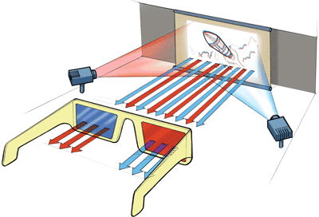
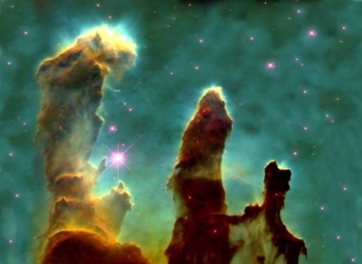
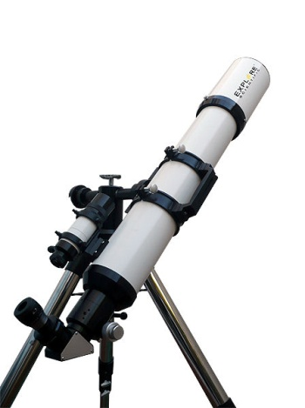
Examples
Source
Detector
hν
Sample
3D Glasses
Astrochemistry
Source
Source
Sample
Detector
Detector
Sample
First homework (not really): Think of examples of absorption spectroscopy
Notes:
Interstellar molecules:
126 molecules in space (diatomics to 13 or 14 atom systems)

Slide 6
Outline
1) Absorption
2) Spectrum Beer's Law
3) Instrument Components
Light sources
Monochrometers
Detectors
Other components
The sample
4) Instrument Architectures
5) UV-Vis in Action
6) Potential Complications
Source
Detector
hν
Sample

Slide 7
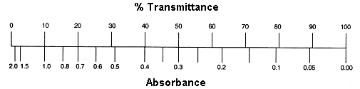
Absorption by the Numbers
hν
hν
Sample
We don’t measure absorbance. We measure transmittance.
Sample
Transmittance:
T = P/P₀
P₀
P
Absorbance:
A = -log T = log P₀/P
(power in)
(power out)

Slide 8
Beer’s Law
The Beer-Lambert Law (λ specific):
A = ε c l
Sample
  A = absorbance (unitless, A = log₁₀ P₀/P)
  ε = molar absorptivity (L mol⁻¹ cm⁻¹)
  l = path length of the sample (cm)
  c = concentration (mol/L or M)
P₀
P
(power in)
(power out)
l in cm
Concentration
Absorbance
Path length
Absorbance
Molar Abs.
Absorbance

Slide 9
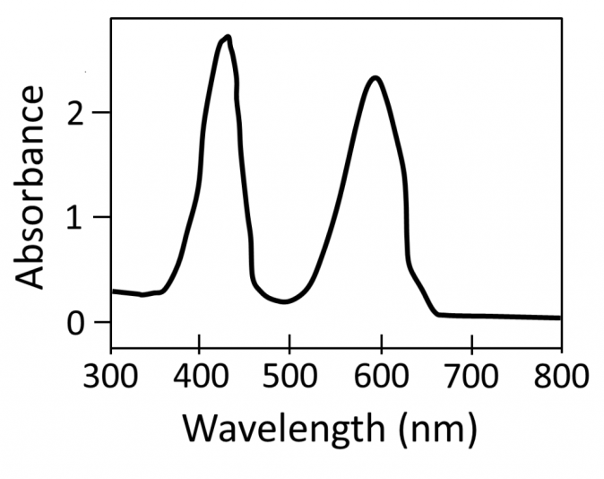
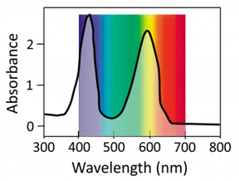
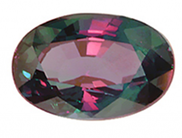
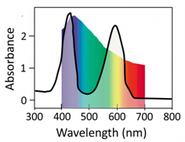
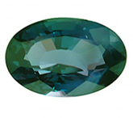
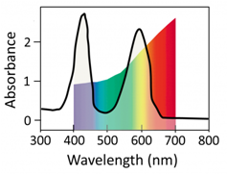
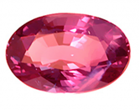
Absorption Spectrum
Alexandrite Gemstone
BeAl₂O₄ (+ Cr³⁺ doping)
Sunlight
Candle/
Incandescent

Slide 10
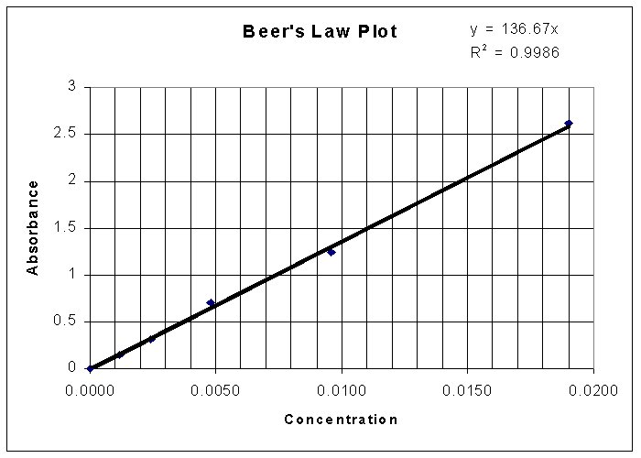
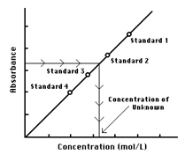
Beer’s Law
The Beer-Lambert Law:
  A = absorbance (unitless, A = log₁₀ P₀/P)
  ε = molar absorbtivity (L mol⁻¹ cm⁻¹)
  l = path length of the sample (cm)
  c = concentration (mol/L or M)
A = ε c l
Find ε
Make a solution of know concentration (C)
Put in a cell of known length (l)
Measure A by UV-Vis
Calculate ε
A = ε c l
y = m x + b
Find Concentrations
Know ε
Put sample in a cell of known length (l)
Measure A by UV-Vis
Calculate C
A = ε c l

Slide 11
Beer’s Law Applied to Mixtures
N719
RuP2
A₁ = ε₁ c₁ l
A_{total} = A₁ + A₂ + A₃…
A_{total} = ε₁ c₁ l + ε₂ c₂ l + ε₃ c₃ l
A_{total} = l(ε₁ c₁ + ε₂ c₂ + ε₃ c₃)

Slide 12
Limitations to Bear’s Law
The Beer-Lambert Law:
Reflection/Scattering
- Air bubbles
- Aggregates
Lamp effects
- Temperature (line broadening)
Light source changes
Solvent lensing
Absorbance too high (above 2)
Local environment effects
Dimerization
Refractive index change (ionic strength)
Sample changes
Photoreaction/decomposition
Side of the cuvette
Hydrogen bonding
Non-uniform through length
A = ε c l
Reflection/Scattering Loss
A = -log T = log P₀/P

Slide 13

Absorption Spectroscopy
Source
Detector
hν
?
?
Sample
Procedure
Step 1: Prepare a sample
Step 2: ???
Step 3: Obtain spectra (Profit!)

Slide 14


Instrumentation
Full spectra detection
Single λ detection
Detector
Detector
Source
hν
Source
hν
Sample
Sample
Sample
Source
hν

Slide 15
Instrumentation
Source
Detector
hν
Sample
Full spectra detection
Single λ detection
Source
Sample
Monochrometer
Area detector
Source
Monochrometer
Sample
“Point” detector
Light sources
Monochrometer
Detectors
Samples

Slide 16
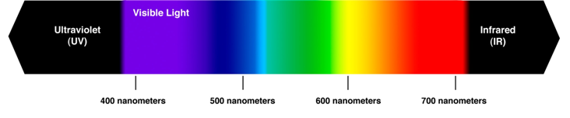
Light Sources, Ideal
Experimentally we would like ~200 – 900 nm
Ideal Light Source
Source
Detector
hν
Sample

Slide 17
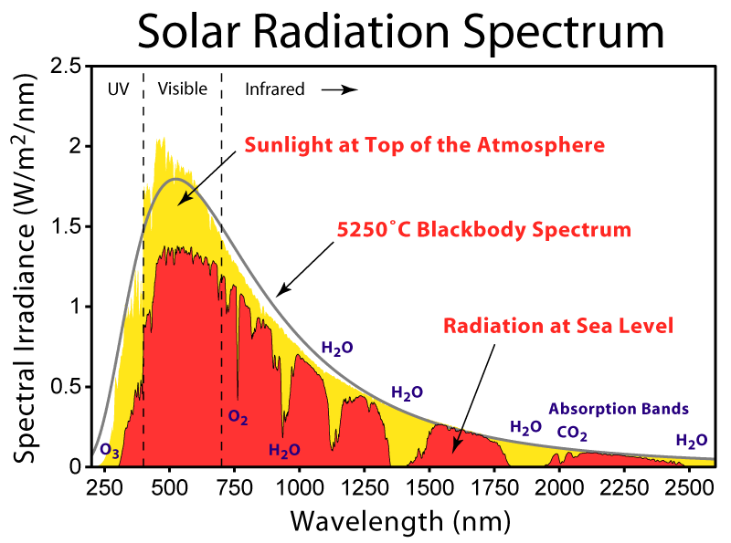
Light Sources: The Sun
Pros:
It’s free!
Does not die
Relatively uniform from 400-800 nm
Cons:
Inconsistent
Minimal UV-light
Intense absorption lines
Detector
hν
Sample

Slide 18
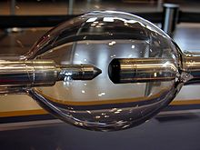
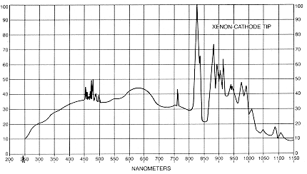
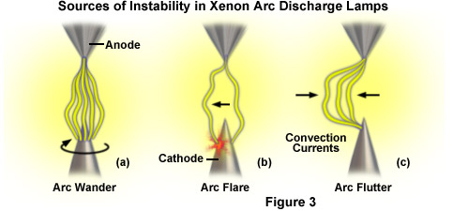
Light Sources: Xe Lamp
Electricity through Xe gas
Pros:
Mimics the sun (solar simulator)
It’s simple
Cons:
Relatively Expensive
Minimal UV-light (<300 nm)
Potential Instability

Slide 19
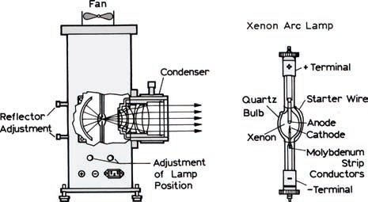
Light Sources: Xe Lamp

Slide 20
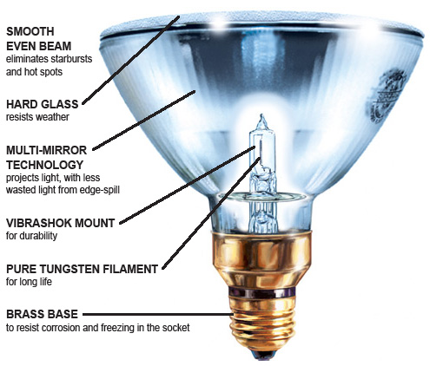
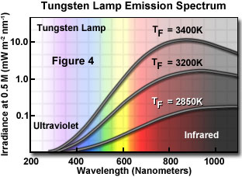
Light Sources: Tungsten Halogen Lamp
Pros:
Compact size
High intensity
Low cost
Long lifetime
Fast turn on
Stable
Cons:
Very hot
Bulb can explode
Minimal UV-light (<300 nm)
Halogen gas and the tungsten filament
Higher pressure (7-8 ATM)

Slide 21
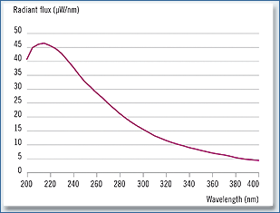
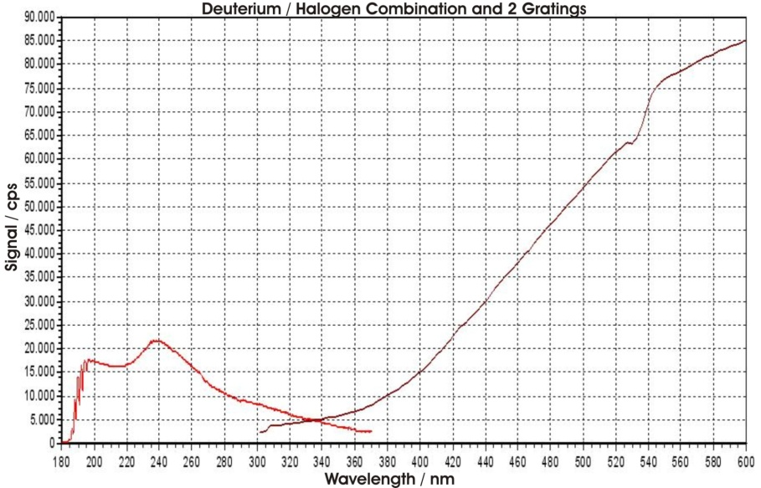
“White” Light
Deuterium lamp
+
      Deuterium lamp –200-330
      Tungsten lamp – >300 nm

Slide 22
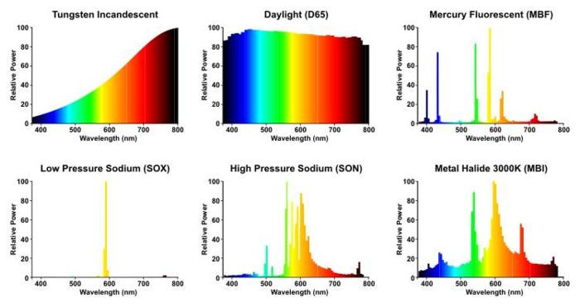
Other Light Sources

Slide 23
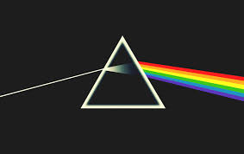
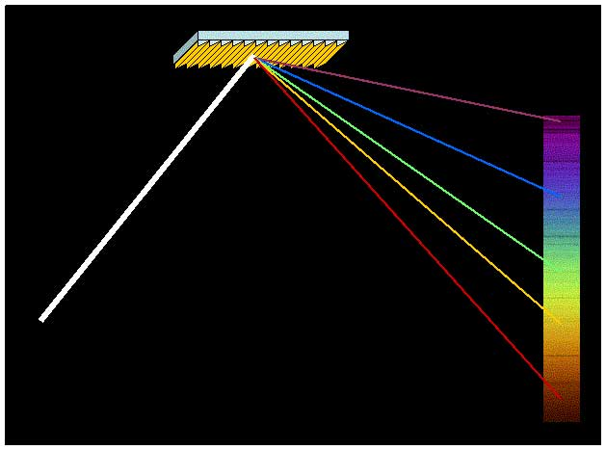
Separating the Light
Source
hν
Sample
Prism
Grating

Slide 24
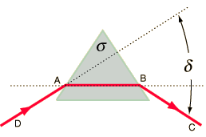
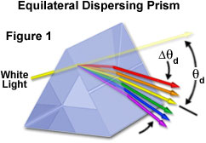

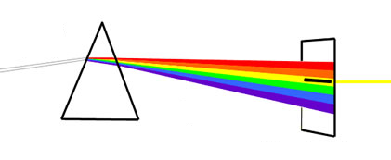
Monochromator: Prism
n₀ is constant
σ is constant
n_{prism} is λ dependent
Wavelength
Deviation
n₀ = refractive index of air
n_{prism} = refractive index of prism
= prism apex angle
δ = deviation angle
Monocromatic
Light
White Light
Prism
Slit

Slide 25
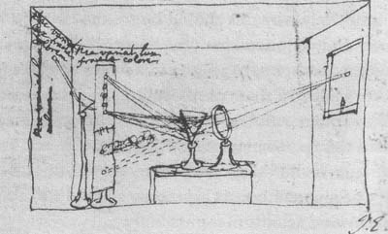
Monochromator: Prism

Slide 26
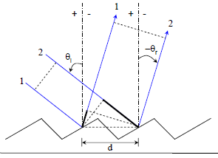
Monochromator: Grating
d is constant
θ_{i} is constant
θ_{r} is λ dependent
Wavelength
Diffraction
Grating
λ = 2d(sin θ_{i} + sin θ_{r})
λ = wavelength
d = grating spacing
θ_{i} = incident angle
θ_{r} = diffracted angle
White Light
Monocromatic
Light
Slit

Slide 27
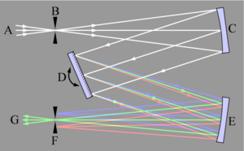
Monochromator: Grating
Source
Grating
Mirrors
Slits

Slide 28
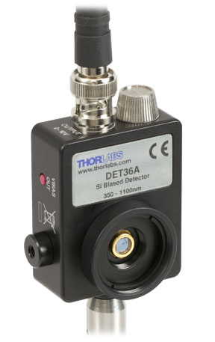
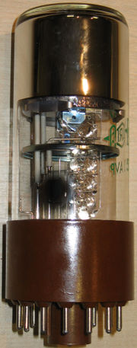
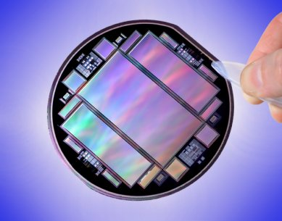
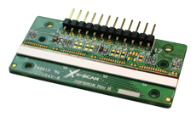
Detectors
Detector
      high sensitivity
      high signal/noise
      constant response for λs
      fast response time
hν
electrical signal
Single λ detection
Full spectra detection
Diode
PMT
CCD
Diode Array

Slide 29
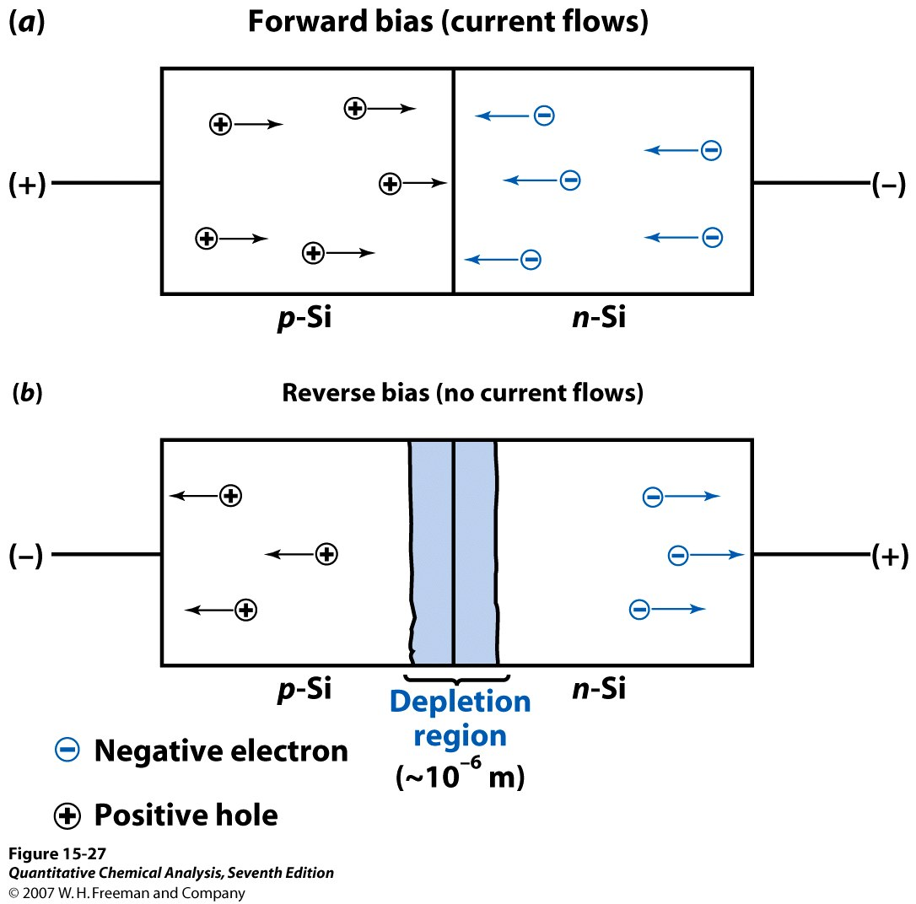
Detectors: Diode
Forward Bias:
Apply a positive potential
holes + e⁻ = exciton = light
Light Emitting Diode
Zero Bias:
Apply 0 potential
exciton = holes + e⁻ = current
silicon solar cell
Negative Bias:
Apply a negative potential
exciton = holes + e⁻ = more current
photodetector
n-type (extra electrons)- P or As doped
p-type (extra holes)- Al or B doped

Slide 30
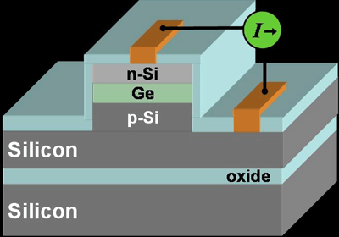
Detectors: Diode
Pros:
Long Lifetime
Small/Compact
Inexpensive
Linear response
190-1000 nm
Cons:
No wavelength discrimination
Minimal internal gain
Much lower sensitivity
Small active area
Slow (>50 ns)
Low dynamic range
0.025 mm wide

Slide 31
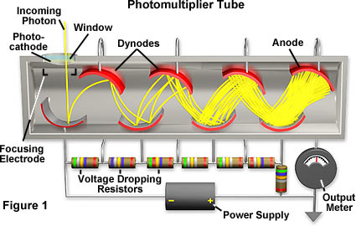
Detectors: PMT
Cathode: 1 photon = 5-20 electrons
More positive potential with each dynode
Operated at -1000 to -2000 V
Notes:
Each is held at a more positive voltage than the previous one

Slide 32
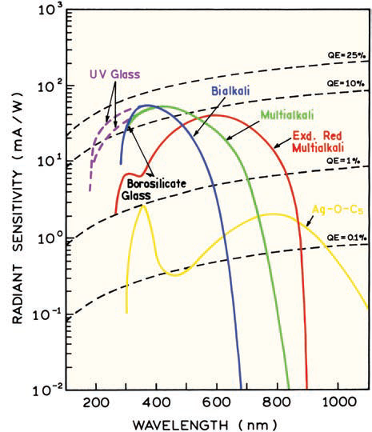
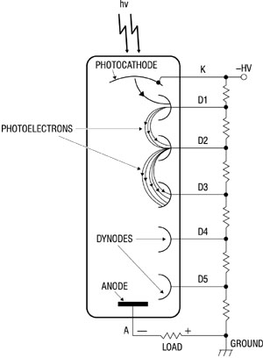
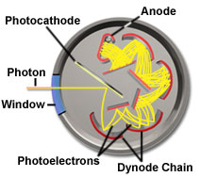
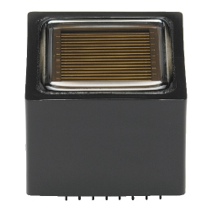
Detectors: PMT
Photocathodes
Architectures
Linear
Circular Cage

Slide 33
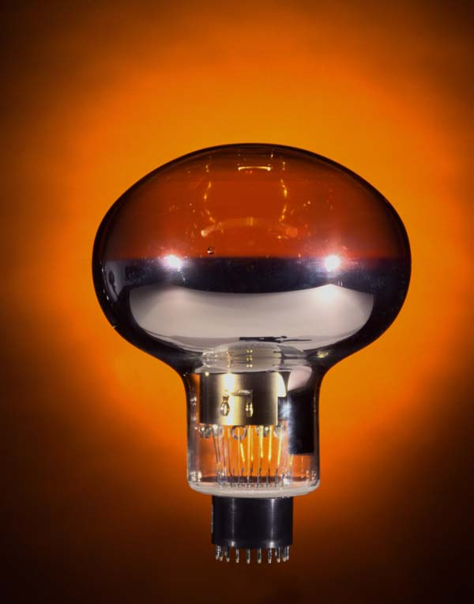

Detectors: PMT
Pros:
Extremely sensitive
UV-Vis-nIR
100,000,000x current amplifier
(single photons)
Low Noise
Compact
Inexpensive ($175-500)
Cons:
No wavelength discrimination
Wavelength dependent τ
Saturation
Magnetic Field Effects

Slide 34


Detectors: PMT
Super-Kamiokande Experiment
1 km underground
h = 40 m, d = 40 m
50,000 tons of water
11,000 PMTs
neutrino + water = Cherenkov Radiation
Notes:
Water emptied and then refilled
Explosion (shockwave), bulb popping cascade
$20-30 million in damaged tubes
2001 60% of the PMTs destroyed in <2 seconds

Slide 35
Instrumentation
Single λ detection
Detector
Detector
Sample
Source
Source
hν
hν
Sample
Full spectra detection
Detector
Source
hν
Sample

Slide 36
Full Spectrum Detection
Detector
Source
hν
Sample
Diode Array
CCD

Slide 37
Detectors: Diode Array
Diode
Pros:
Quick measurement
Full spectra in “real time”
Inexpensive
Less moving parts
Cons:
Lower resolution (~1 nm)
Slow (>50 ns)
More expensive than a single λ
Diode Array
Source
hν
Sample

Slide 38


Detectors: Charge-Coupled Device
Source
hν
Sample

Slide 39

Detectors: CCD
Pros:
Fast
Efficient (~80 % quantum yield)
Full visible spectrum
Wins you the 2006 Nobel Prize (Smith and Boyle)
Cons:
Lower dynamic range
Fast (<50 ns)
Gaps between pixels
Expensive (~$10,000-20,000)

Slide 40
Area Detector Calibration
Detector
650 nm
Source
hν
Sample
Detector Offset
Detector To Close
Blue?
Green?
Red?
Blue?
Green?
Red?
Source
Source
hν
hν
Sample
Sample

Slide 41


Area Detector Calibration
Detector
Photocurrent
Hg Lamp
hν
Length/Area
Hg Lamp Spectrum
Detector
365 nm
436 nm
546 nm
Calibrated
Detector

Slide 42
Instrumentation
Single λ detection
Detector
Detector
Sample
Source
Source
hν
hν
Sample
Full spectra detection
Detector
Source
hν
Sample

Slide 43





Other Components
Chopper
Mirrors
Entrance/Exit Slits
Lenses
Shutter

Slide 44





Other Components
Polarizer
Beam Splitter

Slide 45


Side Note: Pub Highlight
DOI: 10.1021/ja406020r

Slide 46

Side Note: Pub Highlight
DOI: 10.1021/ja406020r

Slide 47



Side Note: Pub Highlight
Hemoglobin Absorption
Biological Tissue Window
Pig Lard Absorption

Slide 48


Side Note: Pub Highlight
Plasmonic Heating
Biological Tissue Window
Photo Drug Delivery

Slide 49



THE SAMPLE
Source
Detector
hν
Sample
Solutions
Solids

Slide 50







The Sample: Cuvette for Solutions
Plastic
Glass
Quartz
Typically 1 x 1 cm
A = ε c l

Slide 51



The Sample: Cuvette
Transmission Window
(—) PC > 340 nm
(—) Polystyrene > 320 nm $0.25
(—) PMMA > 300 nm $0.29
(—) Glass > 270 nm $100
(—) Quartz > 170 nm $200
Acetone
Polystyrene

Slide 52







The Sample: Specialty Cuvettes
Path length
Flow Cell
Spec-echem
A = ε c l
Dilute Samples
10 x 1 cm
1 x 1 cm
Air-free
Gas Cell
Concentrated Samples
0.2 cm
0.5 cm

Slide 53
The Sample: Solvent
    Common solvent cutoffs in nm:
        water 190
        acetonitrile 190
        isooctane 195
        cyclohexane 200
        n-hexane 200
        ethanol 205
        methanol 210
        ether 210
        1,4-dioxane 215
        THF 220
        CH₂Cl₂ 235
        Chloroform 240
        CCl₄ 265
        benzene 280
        toluene 285
        acetone 340
Concentration (typically <50 μM)
Solubility
Ionic strength
Hydrogen bonding
Aggregation
π-stacking
Solvent absorption

Slide 54
The Sample: Solvent
    Common solvent cutoffs in nm:
        water 190
        acetonitrile 190
        isooctane 195
        cyclohexane 200
        n-hexane 200
        ethanol 205
        methanol 210
        ether 210
        1,4-dioxane 215
        THF 220
        CH₂Cl₂ 235
        Chloroform 240
        CCl₄ 265
        benzene 280
        toluene 285
        acetone 340

Slide 55



The Sample: Solvent
Vibrational Structure
Solvatochromism
1,2,4,5-Tetrazine

Slide 56


Correcting for background
P₀
P
A = -log T = log P₀/P
cuvette + solvent + sample
A_{all} = A_{cuvette} + A_{solvent} + A_{sample}
P₀
P
cuvette + solvent
A_{background} = A_{cuvette} + A_{solvent}
We want to know A (log P₀/P) for only our sample!
A_{all} - A_{background} = A_{sample}

Slide 57
Instrument Architectures
Architectures
1) Single Beam
2) Double Beam
  Spatially Separated
  Temporally Separated
A_{all} - A_{background} = A_{sample}
How do we measure background (reference) and sample?

Slide 58

Single Beam Instrument
Sequence of Events
1) Light Source On
2) Reference in holder
3) Open Shutter
4) Measure light (P₀)
5) Raster λ and repeat 4
6) Close Shutter
7) Sample cell in holder
8) Open Shutter
9) Measure intensity (P)
10) Raster λ and repeat 9
11) Close Shutter
Pros:
Simple
Less expensive
Less optics
Less moving parts
Higher light intensity
Can use the same cuvette
Cons:
Changes over time
Better for short term experiments
Manually move samples
A = -log T = log P₀/P

Slide 59



Double Beam Instrument
Spatially Separated
Compensates for:
1) Lamp Fluctuations
2) Temperature changes
3) Amplifier changes
4) Electromagnetic noise
5) Voltage spikes
6) Continuous recording
Temporally Separated

Slide 60
Double Beam Instrument: Spatial
Sequence of Events
1) Light Source On
2) Reference and sample in holder
3) Open Shutter
4) Measure detector 1 (P₀) and 2 (P)
5) Raster λ and repeat 4
6) Close Shutter
Pros:
Both samples simultaneously
Less moving parts (than temporal)
Cons:
Two different cuvettes
Two different detectors
½ the intensity
More expensive
A = -log T = log P₀/P

Slide 61

Double Beam Instrument: Temporal
Sequence of Events
1) Light Source On
2) Reference and sample
3) Rotate Chopper
4) Open Shutter
5) Monitor detector
6) Raster λ and repeat 4
7) Close Shutter
Pros:
Both samples “simultaneously”
Same Detector
Cons:
Two different cuvettes
½ the intensity
rotating mirrors
not really simultaneous
P₀
Current
P
Time
A = -log T = log P₀/P

Slide 62
Instrument Architectures
Single Beam
Double Beam

Slide 63


Instrument Architectures
Agilent 8453: Single Beam, Diode Array Detector

Slide 64


Instrument Architectures
Ocean Optics: Single Beam, CCD Detector

Slide 65

Instrument Architectures
Cary 50: Single Beam, PMT detector

Slide 66


Instrument Architectures
Hitachi U-2900: Double Beam, 2 x PMT detector

Slide 67


Instrument Architectures
Cary 300: Double Beam, PMT detector

Slide 68

Instrument Architectures
Cary 5000: Double Beam, PMT detector

Slide 69




Single Beam Instrument
DIY Spectrometer
$35
http://publiclab.org/wiki/spectrometer

Slide 70







Other Sampling Accessories
Probe-type
Cryostat
Fiber Optics
Microplate Spectrometer

Slide 71


The Sample: Solids
Source
Detector
hν
Solids/Films
More scatter, more reflectance
No reference
Sample

Slide 72
The Sample: Solids
A = -log T = log P₀/P
Sample
Source
Detector
P₀
P
Reflectance
Scatter
P does not take into account reflectance and scatter!
Measured A > Actual A
More scatter/reflectance = More error

Slide 73


The Sample: Solids
Integrating Sphere

Slide 74

Solid Sample
A = -log T = log P₀/P
P₀ ≈ T_{t(without sample)} – R_{d(with sample)}
P ≈ T_{t(with sample)}
A ≈ log (T_{t(without sample)} – R_{d(with sample)}) /T_{t(with sample)}

Slide 75
Outline
1) Beer's Law
2) Absorption Spectrum
3) Instrument Components
Light sources
Monochrometers
Detectors
Other components
The sample
4) Instrument Architectures
5) Applications
6) Limitations
Source
Detector
hν
Sample

Slide 76


HPLC

Slide 77




pK_{a} Determination
Titration of bromocresol green
Bromocresol Green in H₂O
Titrate with base
Monitor pH
Monitor Absorption Change
Graph absorbance vs pH
Inflection point = pK_{a}
- H⁺
+ H⁺
yellow
blue
pK_{a} = 4.8
A @ 615 nm
Isosbestic point

Slide 78
Reaction Kinetics
hν

Slide 79
Real Time Monitoring
UV-Vis
455 nm source
3mL of 40 μM RuBP in pH 1, atm
Monitor: Every 5 min for 180 min
Every 30 min for 180 min
Every 60 min for 3420 min

Slide 80
Spectral Fitting
A → B → C → D → E
Notes:
four consecutive first order reactions, A→B→C→D→E

Slide 81
Spectral Fitting
Table 1. Reaction rate constants for the photodecomposition of RuBP (error in parentheses).ª
Solvent | k_{A→B} (10⁻⁴ s⁻¹) | k_{B→C} (10⁻⁴ s⁻¹) | k_{C→D} (10⁻⁵ s⁻¹) | k_{D→E} (10⁻⁶ s⁻¹)
H₂O | 2.8 (0.06) | 1.3 (0.07) | 3.4 (0.07) | 4.0 (0.6)
D₂O | 8.3 (0.08) | 1.1 (0.02) | 2.9 (0.07) | 4.8 (1.1)
0.1 M HClO₄ | 3.2 (0.3) | 1.5 (0.06) | 2.9 (0.09) | 1.6 (0.4)
0.1 M HClO₄^{b} | 16.4 (1.4) | 2.9 (0.02) | 4.9 (0.04) | 2.9 (0.3)
a) In atmosphere with 455 nm (50 mW/cm²) irradiation unless otherwise noted. b) Bubbled with pure O₂.
Notes:
four consecutive first order reactions, A→B→C→D→E

Slide 82

Potential Complications
With the Sample
Photo Reaction/Decomposition
Concentration to high
- non-linear (A > 2)
- Aggregation
- Refractive index change
Air bubble generation
With the Instrument
Lamp Stability
Room Lighting
Noise
With the Cuvette + Solvent
Cuvette non-uniformity
Sample holder mobility
Lensing (abs + heat)
Temperature (line broadening)

Slide 83
Absorption End
Any Questions?

